Slide 1

Data Types

Slide 2

Exam Objectives
Using Operators and Decision Constructs
Declare and initialize variables (including casting and promoting primitive data types
Identify the scope of variable.
Use local variable type inference

Slide 3
Data & Types
A program is nothing but an exercise in manipulating the data represented by variables and objects.
In order to work with data, every language defines certain basic data types.
Java defines primitive data types :
byte
short
char
int
float
double
boolean

Slide 4
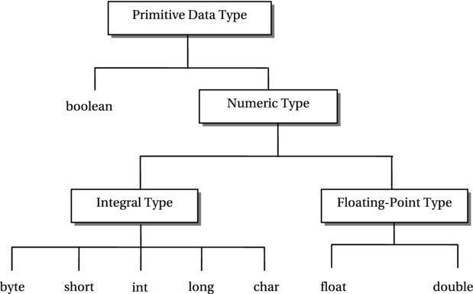
Package

Slide 5
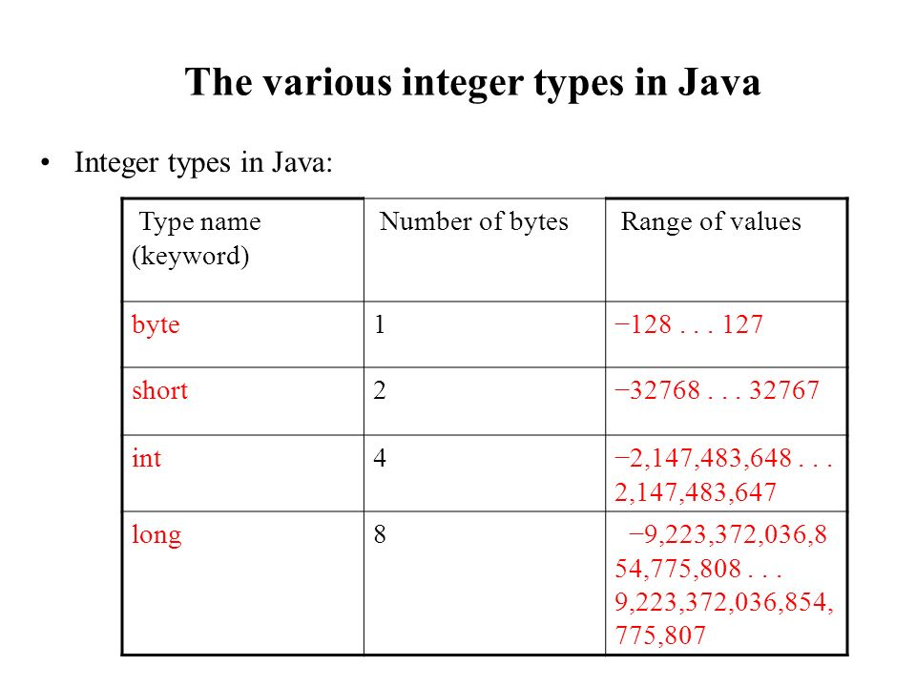
Integral Data Types
Integral values are represented as signed two’s compliment except for character values.
Good to know but not required for exam.
byte
short
char (unsigned)
int
long

Slide 6
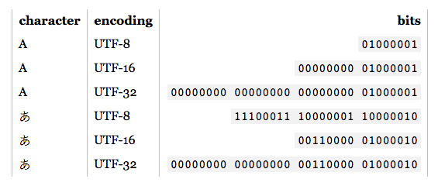
Char: A special case.
Computers understand numbers , so how do we fit in characters. In order to solve this problem ASCII & Unicode character sets were used.
ASCII is a 7-bit character set which means it can have maximum of 128 character representations.
Problem grew larger because number of possible characters was large which includes characters from other languages. To incorporate larger number of character sets Unicode was used to cater to even larger character set with a common standard.
Unicode is written as UTF-8 for 8 bits ,UTF-16 for 16 bits & UTF-32 for 32 bits.
Java uses UTF-16 for character representation.

Slide 7
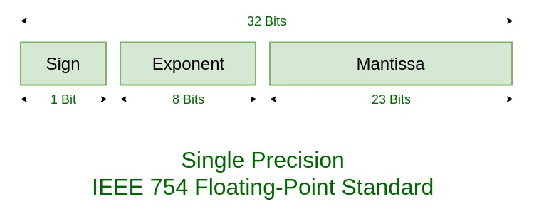
Floating Data Types
Java follows IEEE-754 standard for representation of floating point numbers.
Good to know but not required for exam
float
double

Slide 8

Boolean Data type
A Boolean data type represent value in the form of:
true
False
It majorly used while taking decision and testing for a certain value to be true or false.

Slide 9
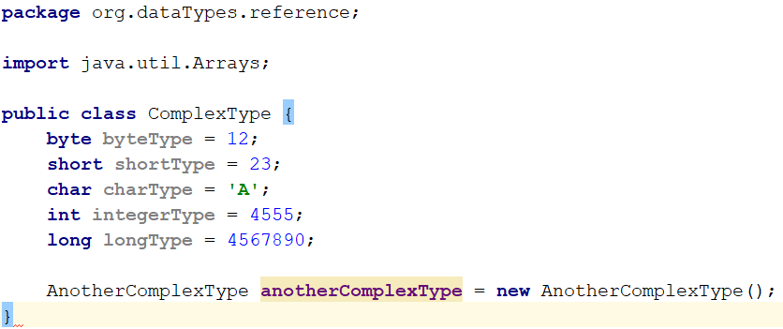
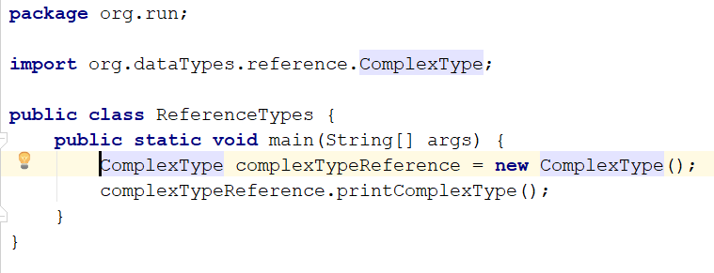
Class : Complex Data types
Complex types are those that are built using the basic primitive data types in java.
A class defines data type which can combine one or more primitive data types or more complex data types.
Objects are the instances of a class & a reference is used to point to that object . Think of the reference as a pointer to instances of the class.
Size of a complex data type ?????? Guess.

Slide 10
Few points to ponder
Null & void
Identifiers & their naming rules.
Uninitialized & default values

Slide 11
Widening & Narrowing Conversions.
Assigning value to a higher data type from lower data type is called as widening conversion. Since the larger data type can hold values of a lower data type hence the compiler allows this conversion to happen implicitly. As a result its referred to as implicit widening conversions.
On the other hand assigning a value from a lower data type to a higher data type is referred to as narrowing conversions. Since this type of conversion may result in a loss of information hence compiler does not allow such types of conversion implicitly. In order to make this assignment possible we need to explicitly tell the compiler to make that assignment. This explicit telling to the compiler happens by the way of ‘cast’.
It might also be taken into consideration that if value of higher data type is within the range of the smaller data type then such type of assignment should be allowed. But the compiler has a problems here. The compiler is not the one executing the code & hence it cannot determine the runtime value of the variable which is why it does not allow implicit narrowing here. The only time this happens when compiler finds a compile time constant.

Slide 12
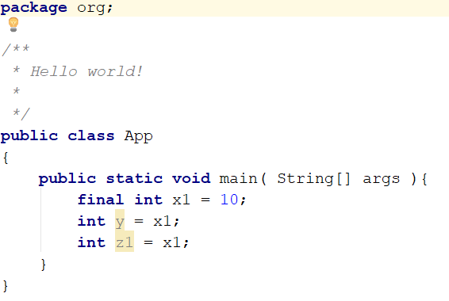
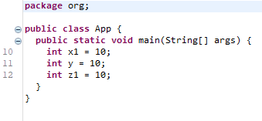
Compile time constants
Compile time constants are variables whose values do not change throughout the course of the program. Hence compiler can definitely know the value of such a value at any point in the program.
Since the value of such a variable is known at the compile time hence compiler allows implicit narrowing in cases where larger data type value lies within the range of lower data type value.
A compile time constant in java is declared using the final keyword.
Ex. final int constantInt = 10;
In the above example value of constantInt is set as final , hence it is a constant variable and it will hold the value 10 throughout the life time of the program
Wherever the constant variable is used in a program the compiler replaces it with exact value of the constant variable. This is depicted in the picture as shown.

Slide 13
Wrapper Classes(Not on exam)
Primitive values in java are not objects. In order to convert primitives into objects and to work in a fully object oriented way wrapper classes were introduced.
There exist wrapper classes for each of the primitive types.
int -> Integer , byte -> Byte , short -> Short , char -> Character
All wrapper class objects are immutable which means no changes can be done to the object of the wrapper class. Whenever a changes happens to the object a new object is created while the original object remains as it is.
All wrapper classes are final, which means it cannot be further extended.
Range of each corresponding wrapper type is same as that of primitive type.
Conversion from primitive to wrapper and vice versa happens automatically. This phenomenon is referred to as autoboxing.

Slide 14

Questions ??
a b c

